Slide 1
Socket Introduction
School of Information and Communication Technology,
Hanoi University of Science and Technology

Slide 2
References
[1] W.Richard Stevens, Unix Network Programming Vol.1, 3rd Ed., Prentice Hall.
[2] Keir Davis, John W. Turner, and Nathan Yocom, The Definitive Guide to Linux Network Programming, Apress.
[3] Michael Donahoo, Kenneth Calvert, TCP/IP Sockets in C: Practical Guide for Programmers, Elsevier.

Slide 3
Content
Socket
Stream Socket
Datagram Socket
APIs for managing names and IP addresses

Slide 4
Socket
Sockets (in plural) are
Application programming interface (API) at transport layer in TCP/IP stack
Application may send and receive data through socket

Slide 5
Socket
Setup socket
Where is the remote machine (IP address, hostname)
What service gets the data (port)
Send and Receive
Designed just like any other I/O in Unix
send – write
recv – read
Close the socket

Slide 6
Socket
The main types of sockets in TCP/IP are
Stream sockets
Use TCP as the end-to-end protocol (with IP underneath) and thus provide a reliable byte-stream service
Datagram sockets
Use UDP (again, with IP underneath) and thus provide a best-effort datagram service
Socket Address :
Combination of host name/Adress IP + transport port

Slide 7
Stream Sockets (TCP)‏
TCP provides connections between clients and servers
TCP also provides reliability :
Acknowledgment
Error control
Flow control
Congestion control
TCP connection is full-duplex
Send and receive data over single connection.

Slide 8
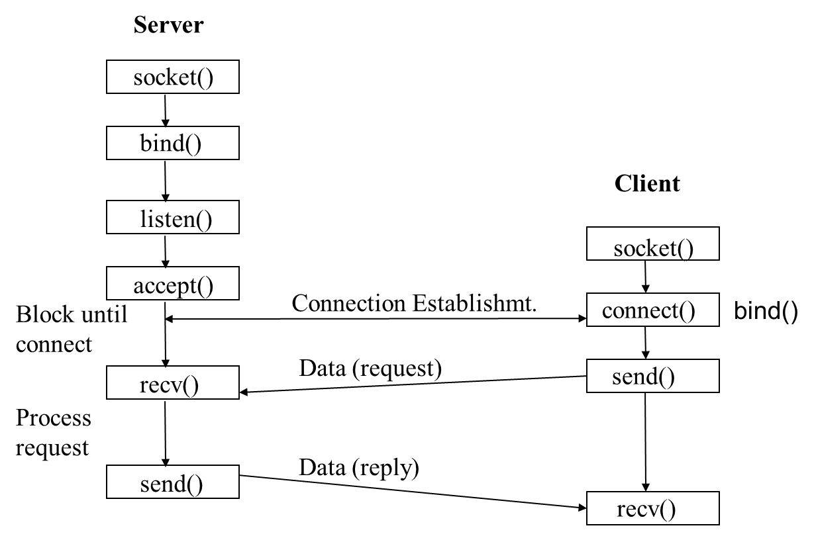
Stream Sockets (TCP)
Working flow

Slide 9
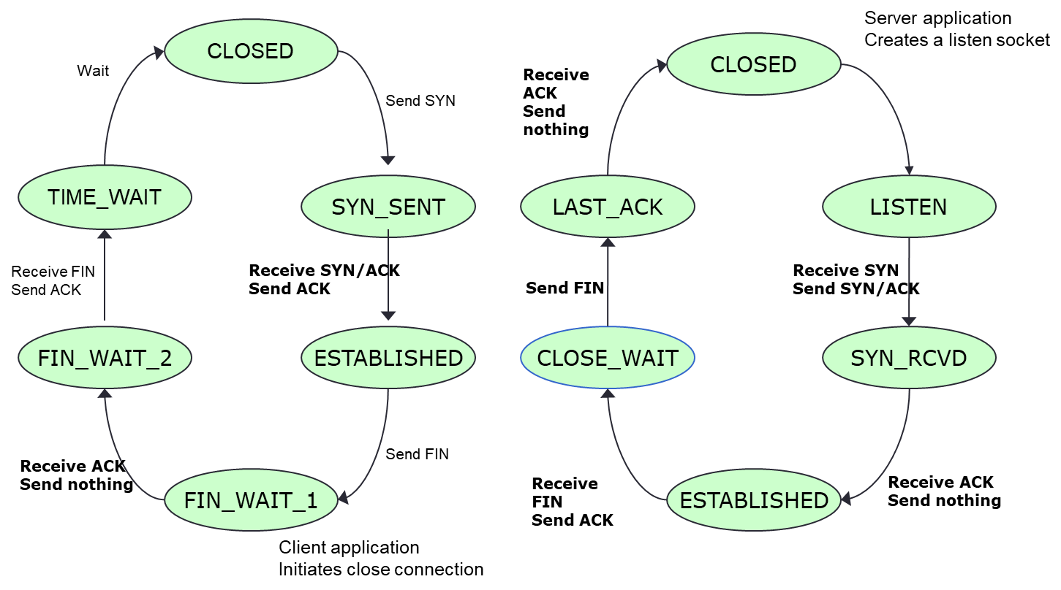
Stream Sockets (TCP)

Slide 10
Stream Sockets (TCP)
C/C++ Programming APIs
socket()
Creates a socket of a given domain, type, protocol (buy a phone)
Returns a file descriptor (called a socket ID)
bind()
Assigns a name to the socket (get a telephone number)
Associate a socket with an IP address and port number (Eg : 192.168.1.1:80)
accept()
server accepts a connection request from a client (answer phone)
There are basically three styles of using accept:
Iterating server: Only one socket is opened at a time.
Forking server: After an accept, a child process is forked off to handle the connection.
Concurrent single server: use select to simultaneously wait on all open socketIds, and waking up the process only when new data arrives

Slide 11
Stream Sockets (TCP)
C/C++ Programming APIs
connect()
Client requests a connection request to a server
This is the first of the client calls
send()
Write data to connection → to the parterner (speak)
recv()
Read data from connection → from the parterner (listen)
close()
Close a socket descriptor (end the call)

Slide 12
Datagram Socket (UDP)‏
UDP is a simple transport-layer protocol
If a datagram is errored or lost, it won’t be automatically retransmitted (can process in application)
UDP provides a connectionless service, as there need not be any long-term relationship between a UDP client and server

Slide 13
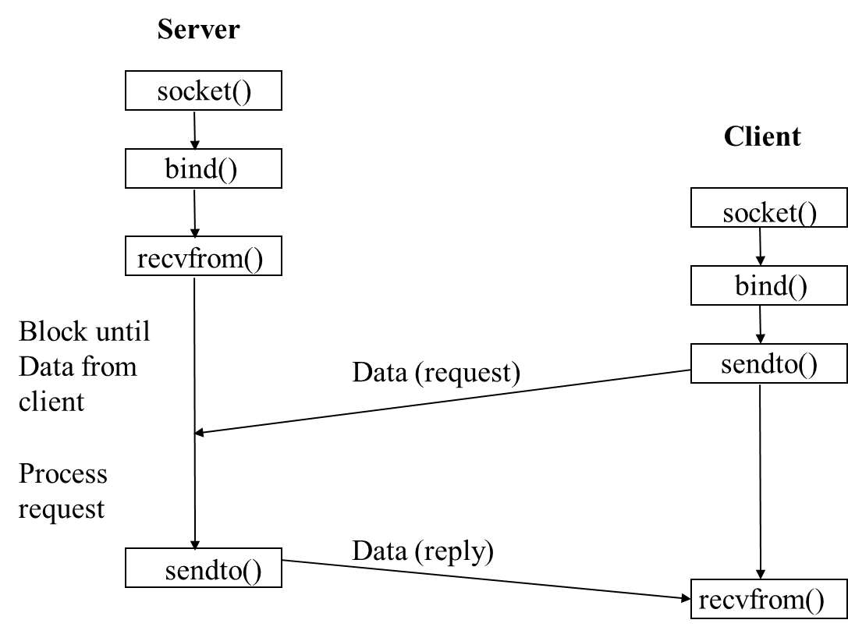
Datagram Socket (UDP)‏

Slide 14
C/C++ Headers
Can be found under /usr/include
E.g.: /usr/include/i386-linux-gnu
<stdio.h>
input and output of basic C programs.
<sys/types.h>
Contains definitions of data types used in system calls. These types are used in the next two include files.
<sys/socket.h>
Includes definitions of structures needed for sockets.
<netinet/in.h>
contains constants and structures needed for internet domain addresses.

Slide 15
Socket Address Structures
Most socket functions require a pointer to a socket address structure as an argument.
Each supported protocol suite defines its own socket address structure.
A Socket Address Structure is a structure which has information of a socket to create or connect with it
Types of socket address structures
IPv4
IPv6

Slide 16
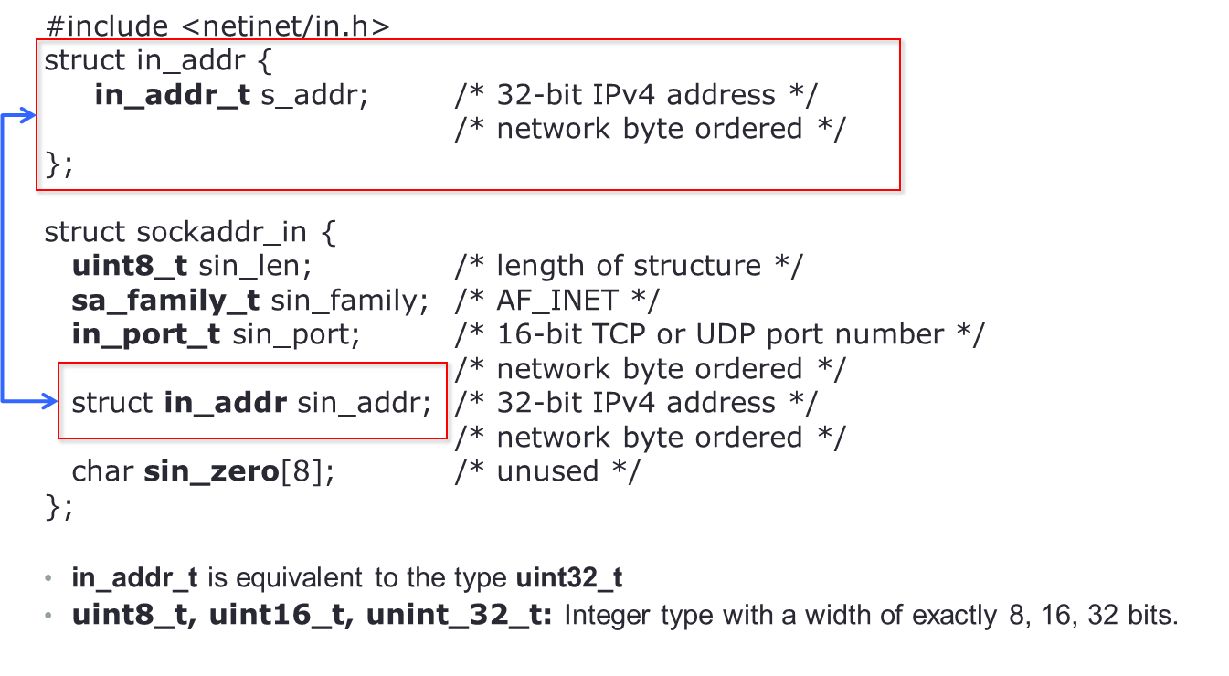
IPv4 Socket Address Structure

Slide 17
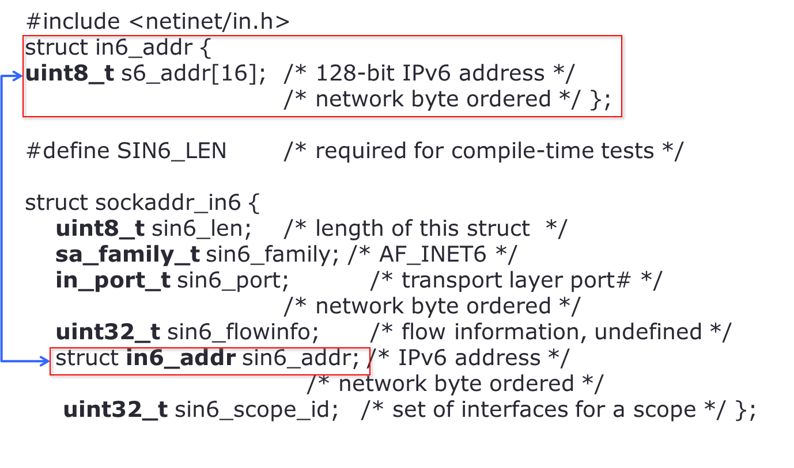
IPv6 Socket Address Structure

Slide 18
Names and IP Addresses APIs
Auxiliary APIs:
All binary values are network byte ordered
htons, htonl, ntohs, ntohl: byte ordering
inet_ntoa(), inet_aton(), inet_addr : Convert IP addresses from a dots-and-number string (eg : 192.168.1.1) to a struct in_addr and back
inet pton, inet ntop: conversion of IP numbers between presentation and strings

Slide 19
Names and IP Addresses APIs
#include <sys/socket.h>
getprotobyname()
Retrieve the protocol name and number corresponding to a protocol name.
getprotobynumber()
Retrieve the protocol name and number corresponding to a protocol number.
List of IP protocol numbers – Wikipedia
getservbyname()
Retrieve the service name and port corresponding to a service name.
getservbyport()
Retrieve the service name and port corresponding to a port.

Slide 20
Names and IP Addresses APIs
struct hostent* gethostbyname (const char* hostname);
Translate DNS host name to IP address (uses DNS)
struct hostent* gethostbyaddr (const char* addr, size_t len, int family);
Translate IP address to DNS host name (not secure)
int gethostname (char* name, size_t namelen);
Read host’s name (use with gethostbyname to find local IP)
getprotobyname()
Retrieve the protocol name and number corresponding to a protocol name.
getprotobynumber()
Retrieve the protocol name and number corresponding to a protocol number.
getservbyname()
Retrieve the service name and port corresponding to a service name.
getservbyport()
Retrieve the service name and port corresponding to a port.

Slide 21
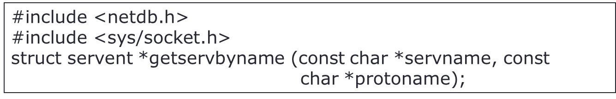
Names and IP Addresses APIs
getservbyname(): Get service information corresponding to a service name and protocol.
Servname: A pointer to a service name.
protoname
An optional pointer to a protocol name.
If this is NULL, getservbyname() returns the first service entry for which the name matches the s_name or one of the s_aliases.
Otherwise getservbyname() matches both the name and the proto.
Returns
non-null pointer if OK
NULL on error
struct servent *sptr = NULL;
sptr = getservbyname(“ftp”, “tcp");

Slide 22
Names and IP Addresses APIs
struct servent {
char *s_name; /* official service name */
char **s_aliases; /* alias list */
int s_port; /* port number, network-byte order */
char *s_proto; /* protocol to use */
};
s_name
Official name of the service.
s_aliases
A NULL-terminated array of alternate names.
s_port
The port number at which the service may be contacted. Port numbers are returned in network byte order.
s_proto
The name of the protocol to use when contacting the service.

Slide 23
Names and IP Addresses APIs
Getservbyport(): Get service information corresponding to a service name and protocol.
servname
A pointer to a service name.
protoname
An optional pointer to a protocol name.
If this is NULL, getservbyname() returns the first service entry for which the name matches the s_name or one of the s_aliases.
Otherwise getservbyname() matches both the name and the proto.
Returns
Non-null pointer if OK
NULL on error
struct servent *sptr;
sptr = getservbyname(“ftp”, “tcp");

Slide 24
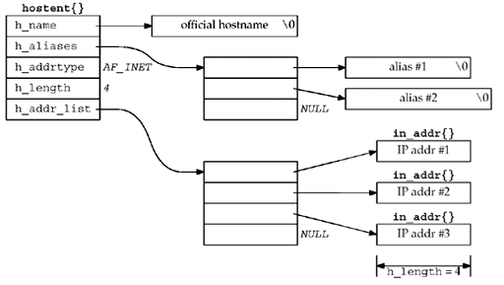
Names and IP Addresses APIs
struct hostent {
char *h_name; /* official (canonical) name of host */
char **h_aliases; /* pointer to array of pointers to alias names */
int h_addrtype; /* host address type: AF_INET */
int h_length; /* length of address: 4 */
char **h_addr_list; /* ptr to array of ptrs with IPv4 addrs */
};

Slide 25
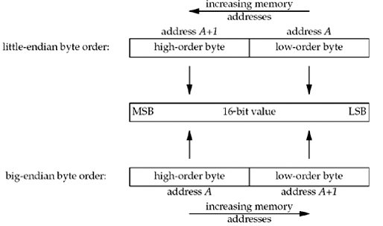
Names and IP Addresses APIs
Byte Ordering
Little-endian byte order (Host)
Big-endian byte order (Network)

Slide 26
Names and IP Addresses APIs
Byte Ordering
There is no standard between these two-byte orderings
The Internet protocols use big-endian byte ordering
Host order can be big- or little-endian
x86, ARM: little-endian
SPARC: big-endian
Conversion
htons(), htonl(): host to network short/long
ntohs(), ntohl(): network order to host short/long

Slide 27
Names and IP Addresses APIs
htons(), htonl(), ntohs(), ntohl()
Convert multi-byte integer types from host byte order to network byte order
Each function returns the converted value
#include <netinet/in.h>
uint32_t htonl(u_long hostlong); // host to network long
uint16_t htons(u_short hostshort);// host to network short
uint32_t ntohl(u_long netlong); // network to host long
uint16_t ntohs(u_short netshort); // network to host short

Slide 28
Names and IP Addresses APIs
char* inet_ntoa (struct in_addr inaddr);
Translate IP address to ASCII dotted-decimal notation (e.g., “128.32.36.37”); not thread-safe
in_addr_t inet_addr (const char* strptr);
Translate dotted-decimal notation to IP address; returns -1 on failure, thus cannot handle broadcast value “255.255.255.255”
int inet_aton (const char* strptr, struct in_addr inaddr);
Translate dotted-decimal notation to IP address; returns 1 on success, 0 on failure

Slide 29
Names and IP Addresses APIs
inet_aton(): Convert IP addresses from a dots-and-number string to a struct in_addr
Return:
The value non-zero if the address is valid
The value 0 if the address is invalid
struct in_addr someAddr;
if(inet_aton(“10.0.0.1”, &someAddr))
printf(“The address is valid”);
else
printf (“The address is invalid”);

Slide 30
Names and IP Addresses APIs
inet_ntoa(): Convert IP addresses from a struct in_addr to a dots-and-number string; return: the dots-and-numbers string
struct in_addr someAddr;
if(inet_aton(“10.0.0.1”, &someAddr))
printf(“The address is valid”);
else
printf (“The address is invalid”);
char *addrStr = NULL;
addrStr = inet_ntoa(someAddr);

Slide 31
IPv4
Developed in APRANET (1960s)
32-bit number
Divided into classes that describe the portion of the address assigned to the network (netID) and the portion assigned to endpoints (hosten)
A : netID – 8 bit
B : netID – 16 bit
C : netID – 24 bit
D : use for multicast
E : use for experiments

Slide 32
IPv6
IPv6 address is 128 bits
To subdivide the available addresses into a hierarchy of routing domains that reflect the Internet's topology
IPv6 address is typically expressed in 16-bit chunks displayed as hexadecimal numbers separated by colons
Example : 21DA:00D3:0000:2F3B:02AA:00FF:FE28:9C5A
or : 21DA:D3:0:2F3B:2AA:FF:FE28:9C5A

Slide 33
New APIs for IPv6
Those APIs only supports IPv4 but IPv6 will be replace IPv4 in the future, so we need APIs supporting IPv6
They are
getaddrinfo
getnameinfo
These APIs have replaced the IPv4 specific routines

Slide 34
Q&A

